Slide 1
Project: Data-Store
DATA- STORE
HOME
ABOUT US
SERVICES
BLOG
PORTFOLIO
CONTACT
Author: Carlos J. Pepin Delgado
<carlos.pepin1@upr.edu>

Slide 2
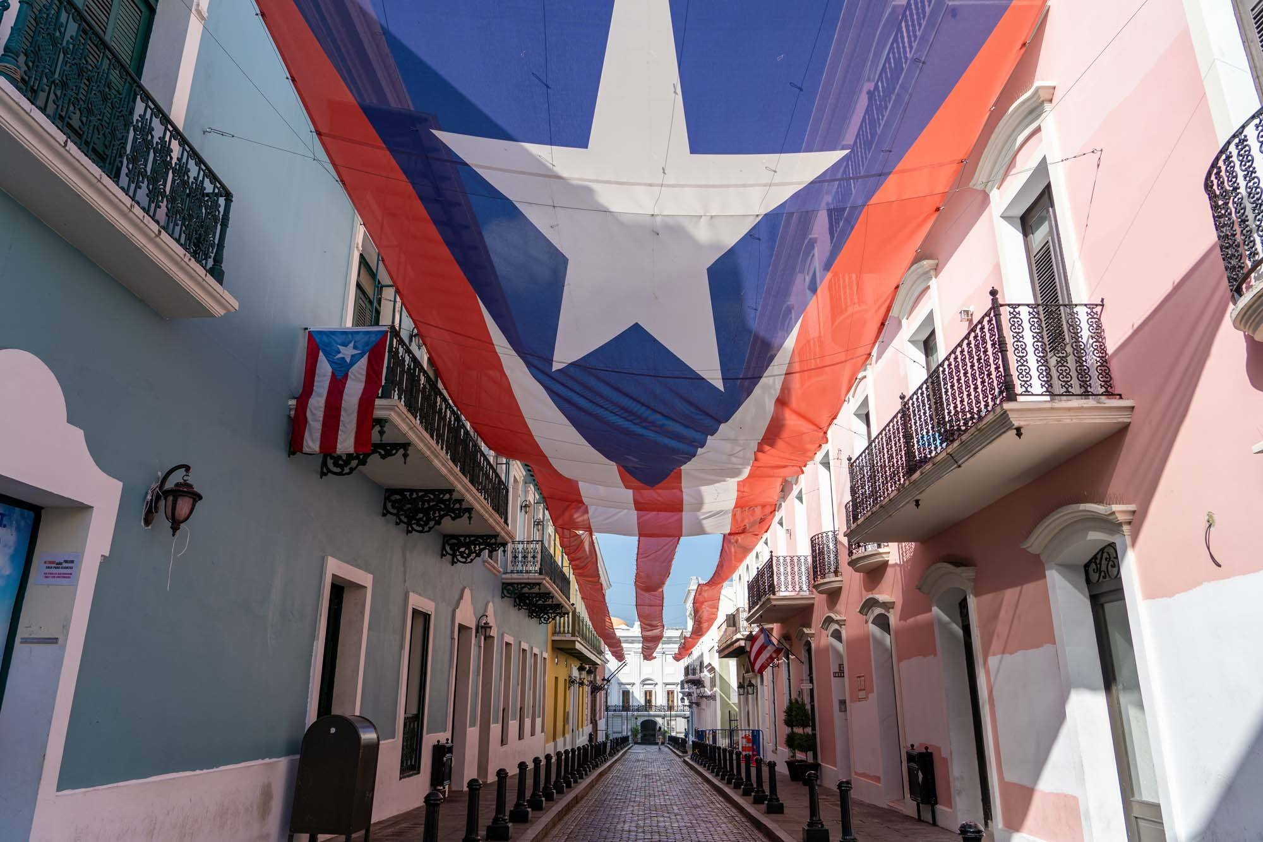


About Me :)
DATA- STORE
HOME
ABOUT US
SERVICES
BLOG
PORTFOLIO
CONTACT
From Puerto Rico 🏝️
I like doing outdoor activities
Love fishing 🎣

Slide 3
Project Overview
DATA- STORE
HOME
ABOUT US
SERVICES
BLOG
PORTFOLIO
CONTACT
I developed an online store platform similar to Amazon or eBay 🛒. This platform is designed to help e-commerce companies and entrepreneurs expand their businesses 🚀.
Key Features:
Persistent Data Storage: Integrates a MySQL database to ensure all information on the website is stored persistently 🔍.
Easy Access: Provides accessibility through REST APIs for seamless backend data fetching 🖥️.

Slide 4
Technical Challenge
DATA- STORE
HOME
ABOUT US
SERVICES
BLOG
PORTFOLIO
CONTACT
Add Store
One of the technical challenges I faced was handling POST requests to update pages without reloading them. It was tricky to figure out how to dynamically update the web page after creating an entity.
To overcome this, I studied the asynchronous fetching and JavaScript documentation, which helped me understand how to perform asynchronous updates. I also relied on the Ironhack bot for additional guidance.
Name
Location
Employee 1:
Name:

Slide 5
Big Mistake
DATA- STORE
HOME
ABOUT US
SERVICES
BLOG
PORTFOLIO
CONTACT
My biggest mistake was not being specific enough when naming the component classes, which caused some styling errors. This oversight caused problems in the design, and I ended up spending more time fixing these problems than focusing on other important tasks.
In the future, I plan to implement a more organized naming convention to avoid similar issues and improve overall efficiency.

Slide 6
DEMO
STORE DATA
HOME
ABOUT US
SERVICES
BLOG
PORTFOLIO
CONTACT

Slide 7
THANK YOU!
DATA- STORE
HOME
ABOUT US
SERVICES
BLOG
PORTFOLIO
CONTACT
Store-Data
Carlos J. Pepin Delgado
https://github.com/carlospepin23

